Slide 1

Open Access, Open Data, Open Research
Jonathan Rans
Digital Curation Centre, Edinburgh
J.Rans@ed.ac.uk
Twitter: @JNRans
Introduction to Open Science and developing RDM services, Riga, Latvia

Slide 2
Outline of the session
Introduction to open science
Why be open?
Overview of the Horizon 2020 mandate and the Open Data Pilot

Slide 3

What is open science?
Some definitions and clarifications
Image CC-BY-NC-SA by Tom Magllery www.flickr.com/photos/lwr/13442910354

Slide 4
What is open science?
“science carried out and communicated in a manner which allows others to contribute, collaborate and add to the research effort, with all kinds of data, results and protocols made freely available at different stages of the research process.”
Research Information Network, Open Science case studies
www.rin.ac.uk/our-work/data-management-and-curation/
open-science-case-studies

Slide 5
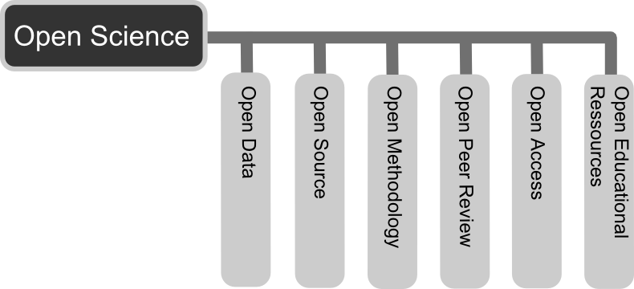
More than open access publishing
CC-BY Andreas Neuhold https://commons.wikimedia.org/wiki/File:Open_Science_-_Prinzipien.png

Slide 6
Open data
“Open data and content can be freely used, modified and shared by anyone for any purpose”
http://opendefinition.org
Tim Berners-Lee’s proposal for five star open data - http://5stardata.info
⬆ | make your stuff available on the Web (whatever format) under an open licence
⬆⬆ | make it available as structured data (e.g. Excel instead of a scan of a table)
⬆⬆⬆ | use non-proprietary formats (e.g. CSV instead of Excel)
⬆⬆⬆⬆ | use URIs to denote things, so that people can point at your stuff
⬆⬆⬆⬆⬆ | link your data to other data to provide context

Slide 7
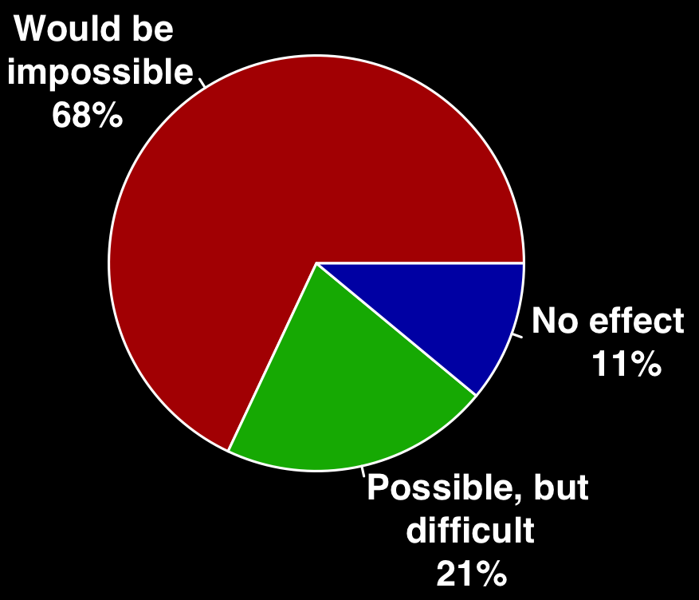
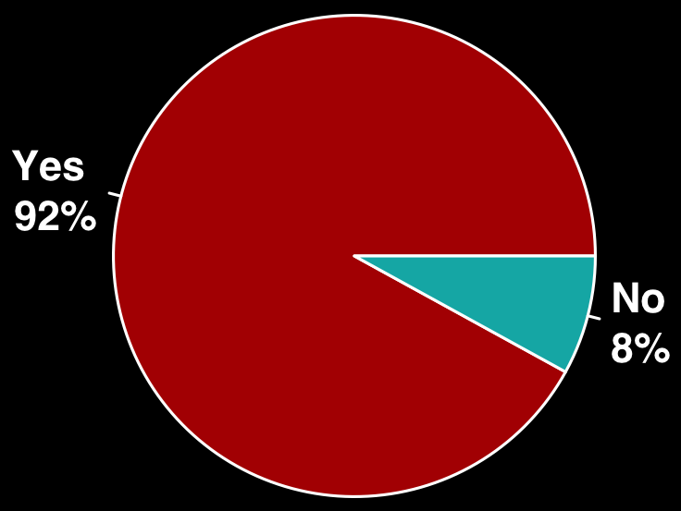
Reliance on specialist research software Slide from Neil Chue-Hong, Software Sustainability Institute
Do you use research software?
What would happen to your research without software
56%
Develop their own software
71%
Have no formal software training
Survey of researchers from 15 UK Russell Group universities conducted by SSI between August - October 2014. DOI: 10.5281/zenodo.14809
Notes:
In the last four years, we have investigated and understood the challenges of the UK research community.
Anecdotally, we had a lot of evidence for people working in this area that researchers relied on software, but there had been no studies conducted. So we did this ourselves.
Two areas of interest, do you use software and possibly more important, what would happen to your research without software – this is 170,000 researchers in the UK who could not conduct their software without software.
This is more than just a reliance on Word or web browsers – specialist software is written into the research workflows of people from psychology to physics, from the life sciences to literature. The reliance isn’t confined to the “traditionally” computationally intensive subjects, it’s a feature of all disciplines.
This means that 140,000 researchers are relying on their own coding skills.

Slide 8

Openness at every stage
Design
Experiment
Analysis
Publication
Release
Change the typical lifecycle
Publish earlier and release more
Papers + Data + Methods + Code…
Support reproducibility
Open science image CC BY-SA 3.0 by Greg Emmerich www.flickr.com/photos/gemmerich/6365692655

Slide 9




Degrees of openness
Five star open data
⬆⬆⬆⬆⬆
Unable to share
Under embargo
Open Restricted Closed
Limits on who can use the data, how or for what purpose
Charges for use
Data sharing agreements
Restrictive licences
Peer-to-peer exchange
…
Content that can be
freely used, modified and shared by anyone
for any purpose

Slide 10

Why Practice open science?
Benefits and drivers
Image CC-BY-NC-SA by wonderwebby www.flickr.com/photos/wonderwebby/2723279491

Slide 11
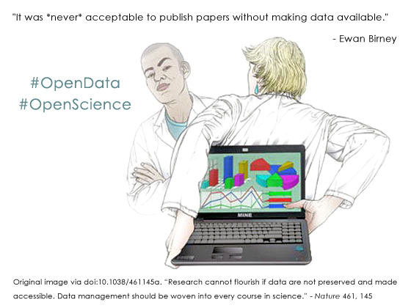
It’s part of good research practice

Slide 12
Some benefits of openness
Relevant literature is accessible – not behind pay walls
Ensures research is transparent and reproducible
Increased visibility, usage and impact of research
New collaborations and research partnerships
Ensure long-term access to the outputs of research
Help increase research efficiency

Slide 13
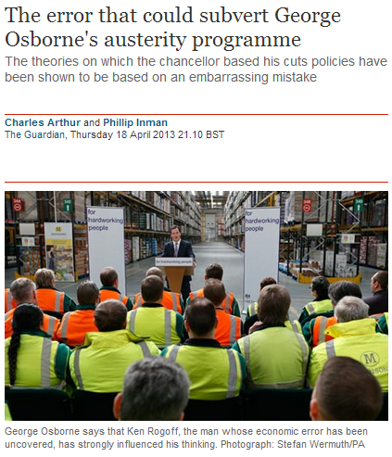
Validation of results
“It was a mistake in a spreadsheet that could have been easily overlooked: a few rows left out of an equation to average the values in a column.
The spreadsheet was used to draw the conclusion of an influential 2010 economics paper: that public debt of more than 90% of GDP slows down growth. This conclusion was later cited by the International Monetary Fund and the UK Treasury to justify programmes of austerity that have arguably led to riots, poverty and lost jobs.”
www.guardian.co.uk/politics/2013/apr/18/uncovered-error-george-osborne-austerity
Notes:
The validation of results is key. This article references an inadvertent error in a economics paper by Reinhadt and Rogoff. Missing some rows out of an average gave drastically different results – what was published suggested that countries with 90% debt ratios see their economies shrink by 0.1%. Instead, it should have found that they grow by 2.2% – less than those with lower debt ratios, but not a spiralling collapse. This mistake wasn’t picked up on initially as the data hadn’t been shared. The mistake fed into government policy - the findings of this paper were used as justification for austerity measures in the UK and various other countries in the EU.

Slide 14
Acceleration of the research process
“As more papers are deposited and more scientists use the repository, the time between an article being deposited and being cited has been shrinking dramatically, year upon year. This is important for research uptake and progress, because it means that in this area of research, where articles are made available at – or frequently before – publication, the research cycle is accelerating.”
Open Access: Why should we have it? Alma Swan www.keyperspectives.co.uk
Notes:
To look at things in a more positive light, this study shows how open access publishing accelerates the research process. It looks at citations rates for articles deposited in arXiv – a preprints repository in maths, physics, astronomy, computer science etc The time lag between deposit and citation of an article has been shrinking drastically year on year. Nowadays the research cycle in High-Energy Physics (HEP) is approaching maximum efficiency as a result of the early and free availability of articles that scientists in the field can use and build upon rapidly.

Slide 15
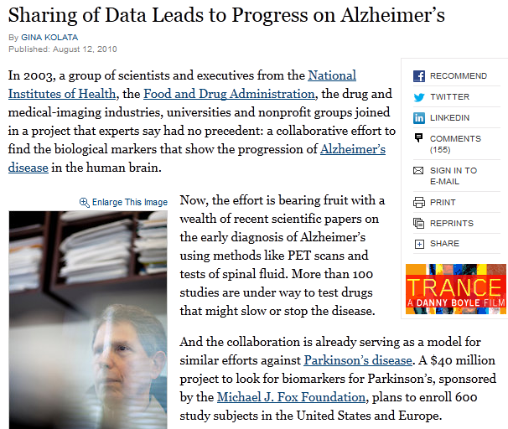
More scientific breakthroughs
“It was unbelievable. Its not science the way most of us have practiced in our careers. But we all realised that we would never get biomarkers unless all of us parked our egos and intellectual property noses outside the door and agreed that all of our data would be public immediately.”
Dr John Trojanowski, University of Pennsylvania
www.nytimes.com/2010/08/13/health/research/13alzheimer.html?pagewanted=all&_r=0
Notes:
Certain research communities have also seen the benefit of sharing data as it speeds up the process of discovery. This article shows how researchers in the field of Alzheimer’s research have agreed as a community to share data immediately to make scientific breakthroughs.

Slide 16
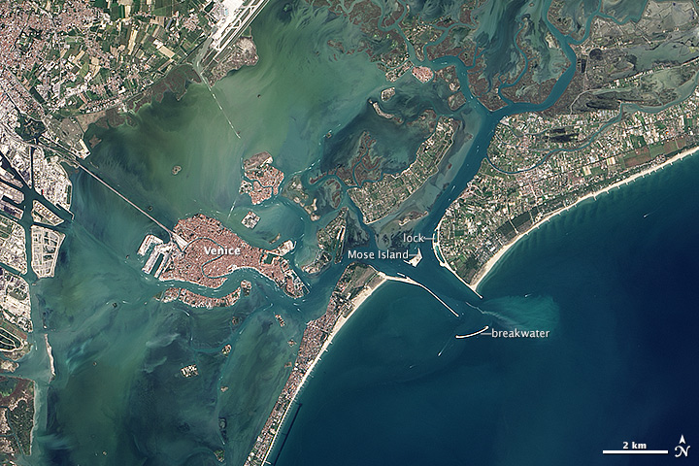
Increased use and economic benefit
The case of NASA Landsat satellite imagery of the Earth’s surface:
Up to 2008
Since 2009
Sold through the US Geological Survey for US$600 per scene
Sales of 19,000 scenes per year
Annual revenue of $11.4 million
Freely available over the internet
Google Earth now uses the images
Transmission of 2,100,000
scenes per year.
Estimated to have created value for the environmental management industry of $935 million, with direct benefit of more than $100 million per year to the US economy
Has stimulated the development of applications from a large number of companies worldwide
http://earthobservatory.nasa.gov/IOTD/view.php?id=83394&src=ve
Notes:
There’s also an economic benefit, as seen by the case of the NASA landsat satellite images. These were sold until 2008 for $600 a scene. Now they’re freely available and used by Google Earth. Previously they sold 19,000 images a year, whereas now they transmit 2.1 million. The revenue has gone up incredibly too from $11.4 million to an estimated value of $935 million with direct benefit of more than $100 million. The release has also stimulated the development of applications from companies worldwide.
This case study comes from the Royal Society Report on Science as an Open Enterprise.

Slide 17
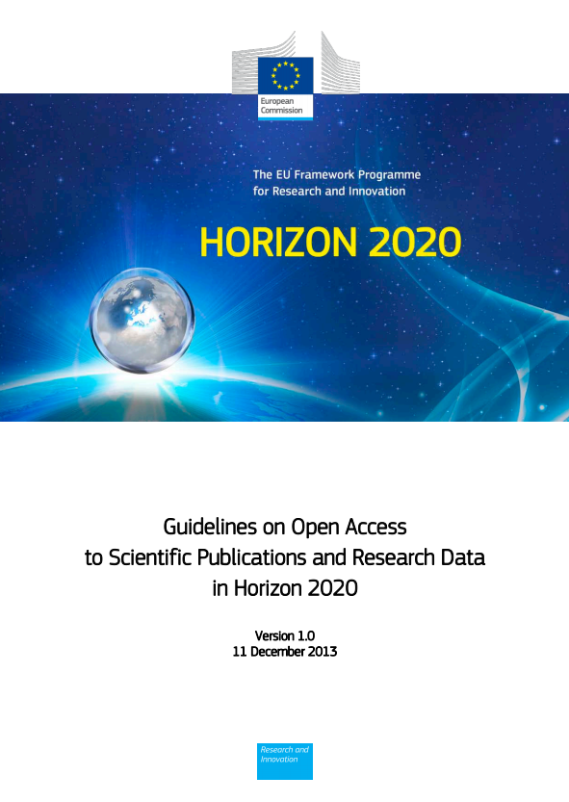
Funder imperatives...
“The European Commission’s vision is that information already paid for by the public purse should not be paid for again each time it is accessed or used, and that it should benefit European companies and citizens to the full.”
http://ec.europa.eu/research/participants/data/ ref/h2020/grants_manual/hi/oa_pilot/h2020-hi-oa-pilot-guide_en.pdf
Notes:
The background to this is about making the most of the data that has been created through publicly funded research. The guidelines speak of:
Improved quality of results
Greater efficiency
Faster to market = faster growth
Improved transparency of the scientific process
17

Slide 18
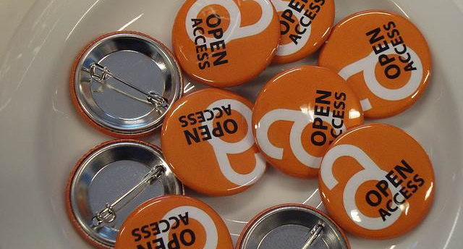
Horizon 2020 and open access
What is required in terms of publications?

Slide 19
Grant Agreement: § 29.2 Open access to scientific publications
Each beneficiary must ensure open access (free of charge, online access for any user) to all peer-reviewed scientific publications relating to its results.
In particular, it must:
(a) as soon as possible and at the latest on publication, deposit a machine-readable electronic copy of the published version or final peer-reviewed manuscript accepted for publication in a repository for scientific publications;
Moreover, the beneficiary must aim to deposit at the same time the research data needed to validate the results presented in the deposited scientific publications.
(b) ensure open access to the deposited publication — via the repository — at the latest:
(i) on publication, if an electronic version is available for free via the publisher, or
(ii) within six months of publication (twelve months for publications in the social sciences and humanities) in any other case.
(c) ensure open access — via the repository — to the bibliographic metadata that identify the deposited publication.
The bibliographic metadata must be in a standard format and must include all of the following:
- the terms ["European Union (EU)" and "Horizon 2020"]["Euratom" and Euratom research and training programme 2014-2018"];
- the name of the action, acronym and grant number;
- the publication date, and length of embargo period if applicable, and
- a persistent identifier.

Slide 20
What does this mean?
Authors are free to choose between the two main and non-exclusive routes toward Open Access
Self-archiving (green open access): the published article or the final peer reviewed manuscript is uploaded in an online repository – access is often delayed (embargo period)
Open access publishing (gold open access): the article is immediately in open access mode, through the publisher. The associated costs (Article Processing Charges) are covered by the author/institution/funder.
The article must always be deposited in a repository, even if the gold route has been chosen.

Slide 21
What to deposit?
The final peer-reviewed manuscript, accepted for publication, including all modifications from the peer-review process
OR
A machine-readable copy of the published version (usually a PDF document)
In principle this applies to all kinds of publications, but emphasis is on peer-reviewed journal articles.

Slide 22
Where to deposit?
Institutional repository
Disciplinary repository (arXiv, Europe PubMed Central, etc.)
Zenodo (www.zenodo.org) if none of the above is available – a EC co-funded, multidisciplinary repository, for publications & data
You can find repositories via registries: ROAR http://roar.eprints.org or OpenDOAR http://www.opendoar.org
A list of publications on the project website is not sufficient.

Slide 23
When to deposit
OPEN ACCESS
Each beneficiary must deposit as soon as possible and at the latest on publication.
Open access must be ensured immediately or after an embargo period:
GREEN – 6-12 months depending on the research area and the choice of journal
GOLD – immediately
Some journals demand longer embargo periods of 6-36 months (compare SHERPA/RoMEO database).

Slide 24

The Open Research Data Pilot
What is required and how to comply?

Slide 25
Open Research Data (ORD) Pilot
Pilot focuses on research data specifically
‘Research data’ refers to information, in particular facts or numbers, collected to be examined and considered as a basis for reasoning, discussion or calculation.
In a research context, examples of data include statistics, results of experiments, measurements, observations resulting from fieldwork, survey results, interview recordings and images. The focus is on research data that is available in digital form.
Guidelines on Open Access to Scientific Publications and Research Data in Horizon 2020 v.1.0, 11 December 2013, Footnote 5, p3

Slide 26
H2020 areas participating in the pilot
Future and Emerging Technologies
Research infrastructures (new: coverage of the whole area)
Leadership in enabling and industrial technologies – Information and Communication Technologies
Nanotechnologies, Advanced Materials, Advanced Manufacturing and Processing, and Biotechnology: ‘nanosafety’ and ‘modelling’ topics (new)
Societal Challenge: Food security, sustainable agriculture and forestry, marine and maritime and inland water research and the bioeconomy - selected topics as specified in the work programme (new)
Societal Challenge: 'Climate Action, Environment, Resource Efficiency and Raw materials' – except raw materials
Societal Challenge: 'Europe in a changing world – inclusive, innovative and reflective Societies'
Science with and for Society
Cross-cutting activities - focus areas – part Smart and Sustainable Cities (moved from Energy WP)
Projects in other areas can participate on a voluntary basis
Notes:
There are seven areas participating in the pilot. This corresponds to about €3 billion or 20% of the overall Horizon 2020 budget in 2014 and 2015.
Projects in others can take part on a voluntary basis. It’s an opt in / opt out basis.
26

Slide 27
Which data does the pilot apply to?
Data, including associated metadata, needed to validate the results in scientific publications
Other curated and/or raw data, including associated metadata, as specified in the DMP
Doesn’t apply to all data (researchers to define as appropriate)
Don’t have to share data if inappropriate – exemptions apply
Notes:
For those that do take part in the pilot, the starting point is to make all data that underpin publications open. After that, it’s for researchers to define what else should be shared and can be made open. This should be outlined in the DMP.
Sometimes sharing is not appropriate (e.g. due to ethical rules of personal data, intellectual property protection, commercial restrictions etc). It’s fine to apply restrictions in such cases. This could be an embargo period prior to publication or while a patent is sought, or controlling access and re-use to protect participants’ identities (e.g. via the use of secure data services / data enclaves or data sharing agreements). Restrictions should be outlined up-front in the DMP.
27

Slide 28
Exemptions – reasons for opting out
If results are expected to be commercially or industrially exploited
If participation is incompatible with the need for confidentiality in connection with security issues
Incompatible with existing rules on the protection of personal data
Would jeopardise the achievement of the main aim of the action
If the project will not generate / collect any research data
If there are other legitimate reasons to not take part in the Pilot
Can opt out at proposal stage OR during lifetime of project
Should describe issues in the project Data Management Plan
Notes:
Projects in these seven areas aren’t forced to participate. There are various reasons to opt out e.g. if results can’t be shared due to confidentiality, legal restrictions or commercial opportunities.
Opt out is available at any point. It can also apply to certain parts of the data e.g. they could share some aspects but not others.
28

Slide 29

Approach:
as open as possible, as closed as necessary
Image: ‘Balancing rocks’ by Viewminder CC-BY-SA-ND www.flickr.com/photos/light_seeker/7780857224

Slide 30
Key requirements of the open data pilot
Beneficiaries participating in the Pilot will:
Deposit data in a research data repository of their choice
Take measures to make it possible for others to access, mine, exploit, reproduce and disseminate the data free of charge
Provide information about tools and instruments necessary for validating the results (where possible, provide the tools and instruments themselves)
Notes:
So the specific requirements on projects that participate in the pilot are to:
- Deposit data in a repository
Enable reuse via open licensing
Provide any tools (or at least info on them) needed to validate the data
The focus is planning for data sharing and then facilitating that through deposit, licensing and enabling reproducibility
30

Slide 31
Data Management Plans
Projects participating in the pilot will be required to develop a Data Management plan (DMP), in which they will specify what data will be open.
Note that the Commission does NOT require applicants to submit a DMP at the proposal stage.
A DMP is therefore NOT part of the evaluation.
DMPs are a deliverable for those participating in the pilot.
Notes:
31

Slide 32
Guidelines from the Commission
Factsheet on Open Access
https://ec.europa.eu/programmes/horizon2020/sites/horizon2020/files/FactSheet_Open_Access.pdf
Guidelines on Open Access to Scientific Publications and Research Data in Horizon 2020
http://ec.europa.eu/research/participants/data/ref/h2020/grants_manual/hi/oa_pilot/h2020-hi-oa-pilot-guide_en.pdf
Guidelines on Data Management in Horizon 2020
http://ec.europa.eu/research/participants/data/ref/h2020/grants_manual/hi/oa_pilot/h2020-hi-oa-data-mgt_en.pdf

Slide 33
Help on understanding the H2020 pilot
OpenAIRE guide on the Open Research Data Pilot
Are you supposed to deposit? > What to deposit > Where to deposit > When to deposit
https://www.openaire.eu/oa-in-h2020/h2020/h2020-oa-data-pilot
Joint statement by OpenAIRE, LIBER and COAR
http://www.slideshare.net/libereurope/horizon-2020-opendatapilot20130703final
Help from your research office and national agencies
e.g. http://www.ucl.ac.uk/research/europe/h2020
e.g. https://www.h2020uk.org/home

Slide 34

Any questions?
DCC resources:
www.dcc.ac.uk/resources
Follow us on twitter:
@digitalcuration and #ukdcc
Acknowledgement: many thanks to Birgit Schmidt for the details on the EC’s open access requirements, courtesy of the FOSTER project

